Slide 1
Artificial Intelligence
Dr. Bidush Kumar Sahoo
G.I.E.T. University,
Gunupur, Odisha

Slide 2
Games in AI
The environment with more than one agent is termed as multi-agent environment, in which each agent is an opponent of other agent and playing against each other. Each agent needs to consider the action of other agent and effect of that action on their performance.
Searches in which two or more players with conflicting goals are trying to explore the same search space for the solution are called adversarial searches, often known as Games.
Games are modeled as a Search problem and heuristic evaluation function, and these are the two main factors which help to model and solve games in AI.

Slide 3
Types of Games in AI
Perfect information: A game with the perfect information is that in which agents can look into the complete board. Agents have all the information about the game, and they can see each other moves also. Examples are Chess, Checkers, Go, etc.
Imperfect information: If in a game agents do not have all information about the game and not aware with what's going on, such type of games are called the game with imperfect information, such as tic-tac- toe, Battleship, blind, Bridge, etc.
Deterministic games: Deterministic games are those games which follow a strict pattern and set of rules for the games, and there is no randomness associated with them. Examples are chess, Checkers, Go, tic-tac- toe, etc.
Non-deterministic games: Non-deterministic are those games which have various unpredictable events and has a factor of chance or luck. This factor of chance or luck is introduced by either dice or cards. These are random, and each action response is not fixed.

Slide 4
Zero-sum game
Zero-sum games are adversarial search which involves pure competition.
In Zero-sum game each agent's gain or loss of utility is exactly balanced by the losses or gains of utility of another agent.
One player of the game try to maximize one single value, while other player tries to minimize it.
Each move by one player in the game is called as ply.
Chess and tic-tac-toe are examples of a Zero-sum game.
Zero-sum game: Embedded thinking
The Zero-sum game involved embedded thinking in which one agent or player is trying to figure out:
What to do.
How to decide the move
Needs to think about his opponent as well
The opponent also thinks what to do
Each of the players is trying to find out the response of his opponent to their actions. This requires embedded thinking or backward reasoning to solve the game problems in AI.

Slide 5
Formalization of the problem
A game can be defined as a type of search in AI which can be formalized of the following elements:
Initial state: It specifies how the game is set up at the start.
Player(s): It specifies which player has moved in the state space.
Action(s): It returns the set of legal moves in state space.
Result(s, a): It is the transition model, which specifies the result of moves in the state space.
Terminal-Test(s): Terminal test is true if the game is over, else it is false at any case. The state where the game ends is called terminal states.
Utility(s, p): A utility function gives the final numeric value for a game that ends in terminal states s for player p. It is also called payoff function. Example: for tic-tac-toe, utility values are +1, -1, and 0.

Slide 6
Game tree
A game tree is a tree where nodes of the tree are the game states and Edges of the tree are the moves by players. Game tree involves initial state, actions function, and result Function.
Example: Tic-Tac-Toe game tree:
The following figure is showing part of the game-tree for tic-tac-toe game. Following are some key points of the game:
There are two players MAX and MIN.
Players have an alternate turn and start with MAX.
MAX maximizes the result of the game tree
MIN minimizes the result.

Slide 7
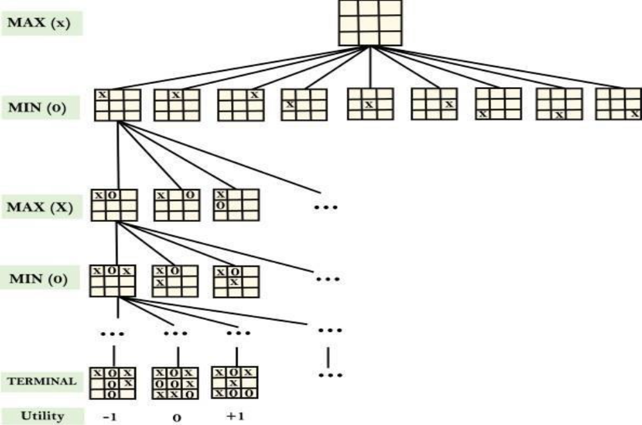

Slide 8
Example Explanation
From the initial state, MAX has 9 possible moves as he starts first. MAX place x and MIN place o, and both player plays alternatively until we reach a leaf node where one player has three in a row or all squares are filled.
Both players will compute each node, minimax, the minimax value which is the best achievable utility against an optimal adversary.
Suppose both the players are well aware of the tic-tac-toe and playing the best play. Each player is doing his best to prevent another one from winning. MIN is acting against Max in the game.
So in the game tree, we have a layer of Max, a layer of MIN, and each layer is called as Ply. Max place x, then MIN puts o to prevent Max from winning, and this game continues until the terminal node.
In this either MIN wins, MAX wins, or it's a draw. This game-tree is the whole search space of possibilities that MIN and MAX are playing tic-tac-toe and taking turns alternately.
Hence adversarial Search for the minimax procedure works as follows:
It aims to find the optimal strategy for MAX to win the game.
It follows the approach of Depth-first search.
In the game tree, optimal leaf node could appear at any depth of the tree.
Propagate the minimax values up to the tree until the terminal node discovered.

Slide 9
Game Playing in Artificial Intelligence
Game Playing is an important domain of artificial intelligence. Games don’t require much knowledge; the only knowledge we need to provide is the rules, legal moves and the conditions of winning or losing the game.
Both players try to win the game. So, both of them try to make the best move possible at each turn. Searching techniques like BFS(Breadth First Search) are not accurate for this as the branching factor is very high, so searching will take a lot of time. So, we need another search procedure that improve –
Generate procedure so that only good moves are generated.
Test procedure so that the best move can be explored first.
The most common search technique in game playing is Minimax search procedure.

Slide 10
Mini-Max Algorithm in Artificial Intelligence
Mini-max algorithm is a recursive or backtracking algorithm which is used in decision-making and game theory. It provides an optimal move for the player assuming that opponent is also playing optimally.
Mini-Max algorithm uses recursion to search through the game-tree.
Min-Max algorithm is mostly used for game playing in AI. Such as Chess, Checkers, tic-tac-toe, go, and various tow-players game. This Algorithm computes the minimax decision for the current state.
In this algorithm two players play the game, one is called MAX and other is called MIN.
Both the players fight it as the opponent player gets the minimum benefit while they get the maximum benefit.
Both Players of the game are opponent of each other, where MAX will select the maximized value and MIN will select the minimized value.
The minimax algorithm performs a depth-first search algorithm for the exploration of the complete game tree.
The minimax algorithm proceeds all the way down to the terminal node of the tree, then backtrack the tree as the recursion.

Slide 11
Working of Min-Max Algorithm
The working of the minimax algorithm can be easily described using an example. Below we have taken an example of game-tree which is representing the two-player game.
In this example, there are two players one is called Maximizer and other is called Minimizer.
Maximizer will try to get the Maximum possible score, and Minimizer will try to get the minimum possible score.
This algorithm applies DFS, so in this game-tree, we have to go all the way through the leaves to reach the terminal nodes.
At the terminal node, the terminal values are given so we will compare those value and backtrack the tree until the initial state occurs.

Slide 12
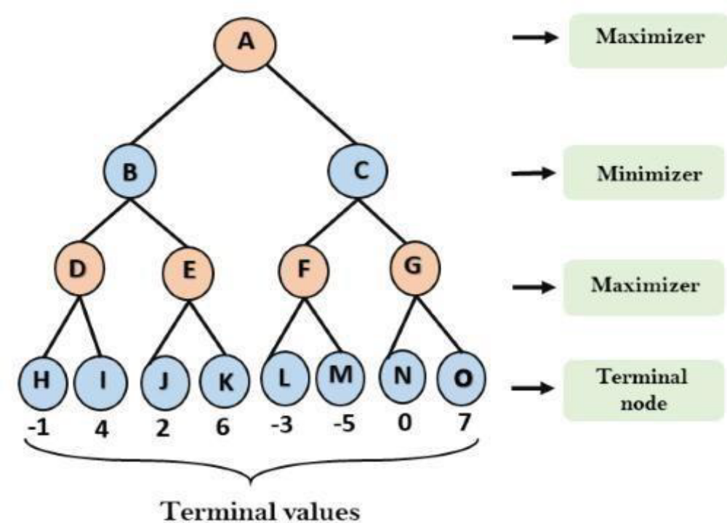

Slide 13
Step-1: In the first step, the algorithm generates the entire game-tree and apply the utility function to get the utility values for the terminal states. In the below tree diagram, let's take A is the initial state of the tree. Suppose maximizer takes first turn which has worst-case initial value =- infinity, and minimizer will take next turn which has worst-case initial value = +infinity.
Step 2: Now, first we find the utilities value for the Maximizer, its initial value is -∞, so we will compare each value in terminal state with initial value of Maximizer and determines the higher nodes values. It will find the maximum among the all.
For node D max(-1,- -∞) => max(-1,4)= 4
For Node E max(2, -∞) => max(2, 6)= 6
For Node F max(-3, -∞) => max(-3,-5) = -3
For node G max(0, -∞) = max(0, 7) = 7

Slide 14
Step 3: In the next step, it's a turn for minimizer, so it will compare all nodes value with +∞, and will find the 3rd layer node values.
For node B= min(4,6) = 4
For node C= min (-3, 7) = -3
Step 4: Now it's a turn for Maximizer, and it will again choose the maximum of all nodes value and find the maximum value for the root node. In this game tree, there are only 4 layers, hence we reach immediately to the root node, but in real games, there will be more than 4 layers.
For node A max(4, -3)= 4

Slide 15
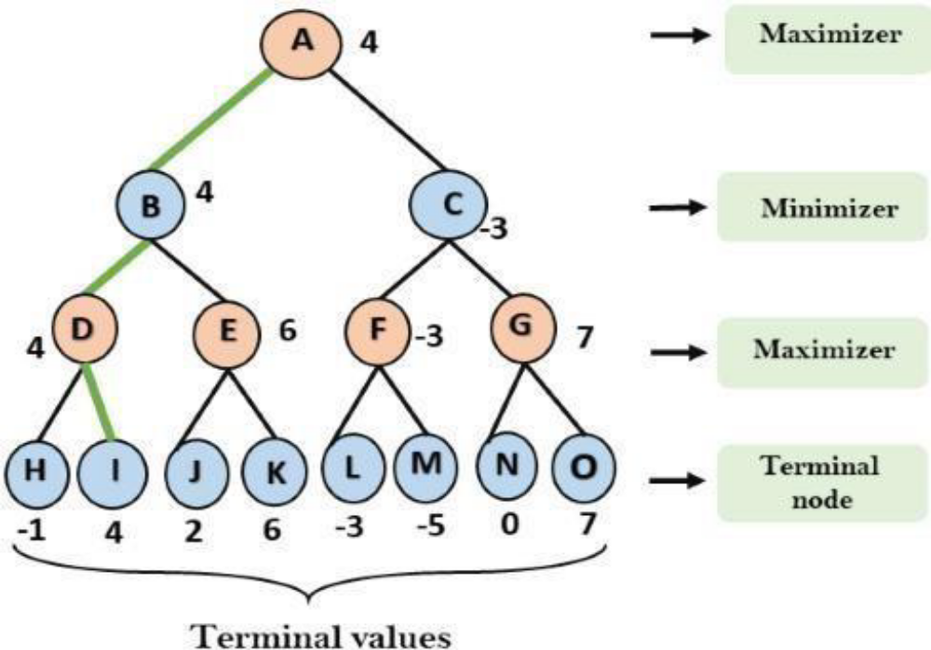

Slide 16
Properties of Mini-Max algorithm:
Complete- Min-Max algorithm is Complete. It will definitely find a solution (if exist), in the finite search tree.
Optimal- Min-Max algorithm is optimal if both opponents are playing optimally.
Time complexity- As it performs DFS for the game-tree, so the time complexity of Min-Max algorithm is O(bm), where b is branching factor of the game-tree, and m is the maximum depth of the tree.
Space Complexity- Space complexity of Mini-max algorithm is also similar to DFS which is O(bm).
Limitation of the minimax Algorithm:
The main drawback of the minimax algorithm is that it gets really slow for complex games such as Chess, go, etc. This type of games has a huge branching factor, and the player has lots of choices to decide. This limitation of the minimax algorithm can be improved from alpha-beta pruning which we have discussed in the next topic.

Slide 17
Alpha-Beta Pruning
Alpha-beta pruning is a modified version of the minimax algorithm. It is an optimization technique for the minimax algorithm.
As we have seen in the minimax search algorithm that the number of game states it has to examine are exponential in depth of the tree. Since we cannot eliminate the exponent, but we can cut it to half. Hence there is a technique by which without checking each node of the game tree we can compute the correct minimax decision, and this technique is called pruning. This involves two threshold parameter Alpha and beta for future expansion, so it is called alpha-beta pruning. It is also called as Alpha-Beta Algorithm.
Alpha-beta pruning can be applied at any depth of a tree, and sometimes it not only prune the tree leaves but also entire sub-tree.
The two-parameter can be defined as:
Alpha: The best (highest-value) choice we have found so far at any point along the path of Maximizer. The initial value of alpha is -∞.
Beta: The best (lowest-value) choice we have found so far at any point along the path of Minimizer. The initial value of beta is +∞.
The Alpha-beta pruning to a standard minimax algorithm returns the same move as the standard algorithm does, but it removes all the nodes which are not really affecting the final decision but making algorithm slow. Hence by pruning these nodes, it makes the algorithm fast.

Slide 18
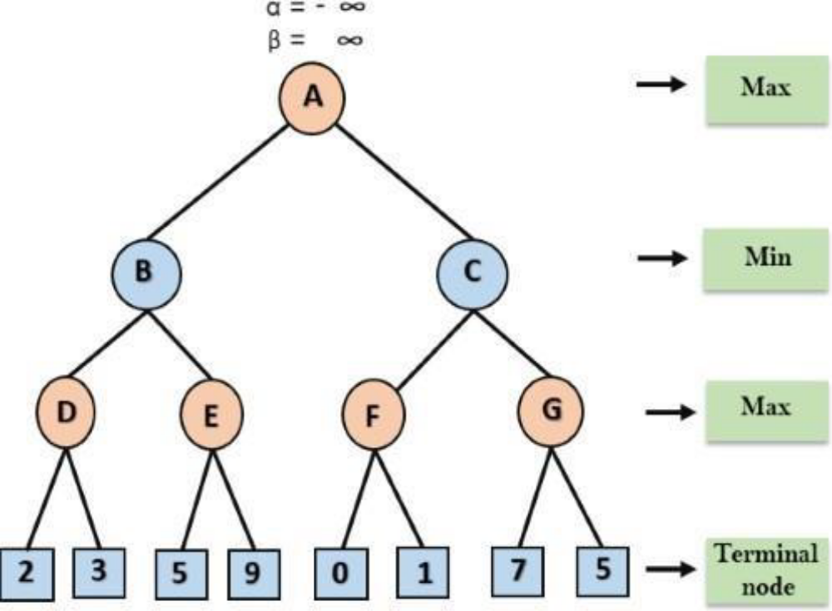

Slide 19
Working of Alpha-Beta Pruning
Step 1: At the first step the, Max player will start first move from node A where α= -∞ and β= +∞, these value of alpha and beta passed down to node B where again α= -∞ and β= +∞, and Node B passes the same value to its child D.
Step 2: At Node D, the value of α will be calculated as its turn for Max. The value of α is compared with firstly 2 and then 3, and the max (2, 3) = 3 will be the value of α at node D and node value will also 3.
Step 3: Now algorithm backtrack to node B, where the value of β will change as this is a turn of Min, Now β= +∞, will compare with the available subsequent nodes value, i.e. min (∞, 3) = 3, hence at node B now α= -∞, and β= 3.
In the next step, algorithm traverse the next successor of Node B which is node E, and the values of α= -∞, and β= 3 will also be passed.
Step 4: At node E, Max will take its turn, and the value of alpha will change. The current value of alpha will be compared with 5, so max (-∞, 5) = 5, hence at node E α= 5 and β= 3, where α>=β, so the right successor of E will be pruned, and algorithm will not traverse it, and the value at node E will be 5.

Slide 20
Step 5: At next step, algorithm again backtrack the tree, from node B to node A. At node A, the value of alpha will be changed the maximum available value is 3 as max (-∞, 3)= 3, and β= +∞, these two values now passes to right successor of A which is Node C.
At node C, α=3 and β= +∞, and the same values will be passed on to node F.
Step 6: At node F, again the value of α will be compared with left child which is 0, and max(3,0)= 3, and then compared with right child which is 1, and max(3,1)= 3 still α remains 3, but the node value of F will become 1.
Step 7: Node F returns the node value 1 to node C, at C α= 3 and β= +∞, here the value of beta will be changed, it will compare with 1 so min (∞, 1) = 1. Now at C, α=3 and β= 1, and again it satisfies the condition α>=β, so the next child of C which is G will be pruned, and the algorithm will not compute the entire sub-tree G.
Step 8: C now returns the value of 1 to A here the best value for A is max (3, 1) = 3. Following is the final game tree which is the showing the nodes which are computed and nodes which has never computed. Hence the optimal value for the maximizer is 3

Slide 21
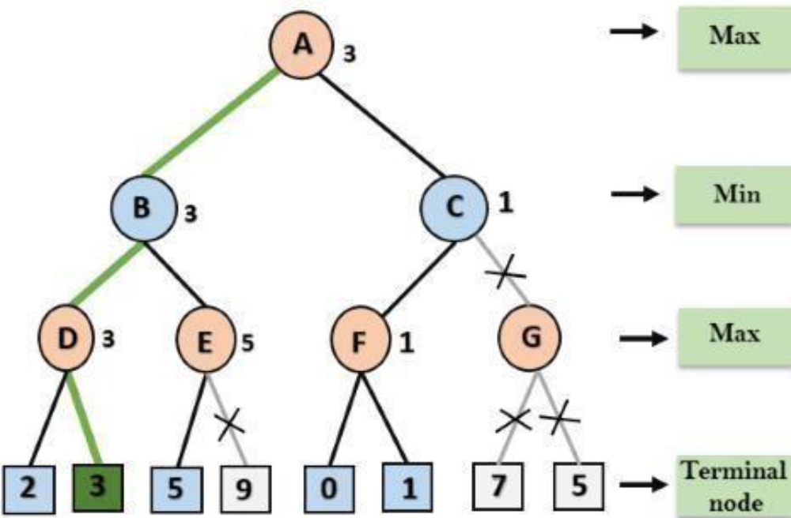

Slide 22
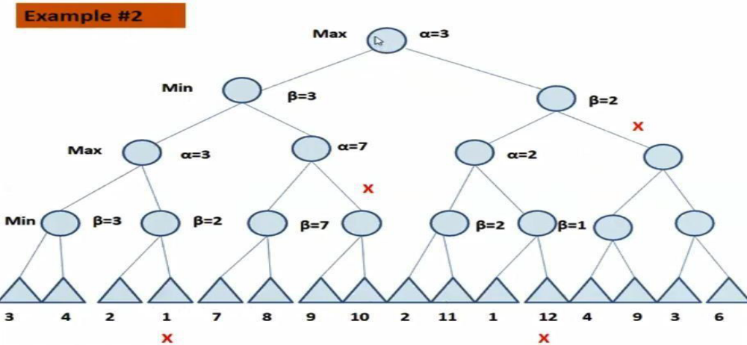

Slide 23
Iterative Deepening
Iterative deepening depth-first Search (IDDFS):
The iterative deepening algorithm is a combination of DFS and BFS algorithms. This search algorithm finds out the best depth limit and does it by gradually increasing the limit until a goal is found.
This algorithm performs depth-first search up to a certain "depth limit", and it keeps increasing the depth limit after each iteration until the goal node is found.
This Search algorithm combines the benefits of Breadth-first search's fast search and depth-first search's memory efficiency.
The iterative search algorithm is useful uninformed search when search space is large, and depth of goal node is unknown.
Advantages:
It combines the benefits of BFS and DFS search algorithm in terms of fast search and memory efficiency.
Disadvantages:
The main drawback of IDDFS is that it repeats all the work of the previous phase.

Slide 24
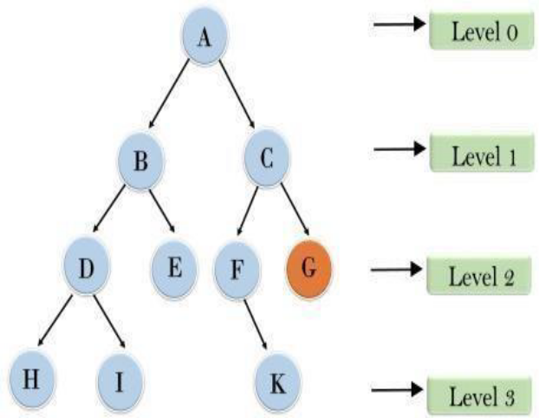
The following tree structure is showing the iterative deepening depth-first search. IDDFS algorithm performs various iterations until it does not find the goal node. The iteration performed by the algorithm is given as:
1'st Iteration ---- > A
2'nd Iteration --- > A, B, C
3'rd Iteration ----- >A, B, D, E, C, F, G
4'th Iteration ------ >A, B, D, H, I, E, C, F, K, G
In the fourth iteration, the algorithm will find the goal node.
Completeness:
This algorithm is complete is if the branching factor is finite.
Time Complexity:
Let's suppose b is the branching factor and depth is d then the worst-case time complexity is O(bd).
Space Complexity:
The space complexity of IDDFS will be O(bd). Optimal:
IDDFS algorithm is optimal if path cost is a non- decreasing function of the depth of the node.

Slide 25
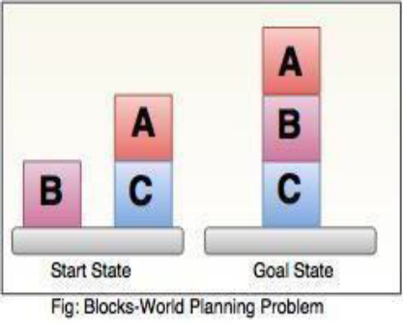
Planning in AI
The planning in Artificial Intelligence is about the decision making tasks performed by the robots or computer programs to achieve a specific goal.
The execution of planning is about choosing a sequence of actions with a high likelihood to complete the specific task.
The Blocks World Problem
In order to compare the variety of methods of planning, we should find it useful to look at all of them in a single domain that is complex enough that the need for each of the mechanisms is apparent yet simple enough that easy-to-follow examples can be found.
There is a flat surface on which blocks can be placed.
There are a number of square blocks, all the same size.
They can be stacked one upon the other.
There is robot arm that can manipulate the blocks.

Slide 26
Blocks-World planning problem
The blocks-world problem is known as Sussman Anomaly. In blocks-world problem, three blocks labeled as 'A', 'B', 'C' are allowed to rest on the flat surface. The given condition is that only one block can be moved at a time to achieve the goal. The start state and goal state are shown in the diagram.
Components of a Planning System:
Choose the best rule for applying the next rule based on the best available heuristics.
Apply the chosen rule for computing the new problem state.
Detect when a solution has been found.
Detect dead ends so that they can be abandoned and the system’s effort is directed in more fruitful directions.

Slide 27
Predicates
In order to specify both the conditions under which an operation may be performed and the results of performing it, we need the following predicates:
ON(A, B): Block A is on Block B.
ONTABLES(A): Block A is on the table.
CLEAR(A): There is nothing on the top of Block A.
HOLDING(A): The arm is holding Block A.
ARMEMPTY: The arm is holding nothing.
Actions of the robot arm
UNSTACK(A, B): Pick up block A from its current position on block B.
STACK(A, B): Place block A on block B.
PICKUP(A): Pick up block A from the table and hold it.
PUTDOWN(A): Put block A down on the table. Notice that the robot arm can hold only one block at a time.

Slide 28
Nonlinear Planning Using Constraint Posting
The goal stack planning method attacks problems involving conjoined goals by solving the goals one at a time, in order.
A plan generated by this method contains sequence of operators for attaining the first goal, followed by the complete sequence for the second goal. But, the difficult problems cause goal interactions.
The operators used to solve one sub problem may interfere with the solution to a previous sub problem. Most sub problems require an intertwined plan in which multiple sub-problems are worked on simultaneously.
Such a plan is called nonlinear plan because it is not composed of a linear sequence of complete sub-plans.
Non-linear planning: This planning is used to set a goal stack and is included in the search space of all possible subgoal orderings.
Example:
We want to take the car for servicing and have to make an important phone call. In case of Linear planning, First we will achieve the goal of making a phone call and then will take the car for servicing. Rather than completing both the tasks in a linear way, after completion of the task 1, as partial step, i.e., start the car and put on the Bluetooth, then complete the task 2 of phone call and then finally, complete the task 1 by leaving the car at the service station. This can be an example of non-linear planning.
There is a technique called constraint posting that often comes with Non-Linear Planning. The idea of constraint posting is to build up a plan by incrementally.

Slide 29
Constraint Posting
The idea of constraint posting is to build up a plan by incrementally hypothesizing operators, partial orderings between operators, and binding of variables within operators.
At any given time in the problem-solving process, we may have a set of useful operators but perhaps no clear idea of how those operators should order with respect to each other.
A solution is a partially ordered, partially instantiated set
Algorithm: Nonlinear Planning (TWEAK)
Initialize S to be the set of propositions in the goal state.
Remove some unachieved proposition P from S.
Moreover, Achieve P by using step addition, promotion, Declobbering, simple establishment or separation.
Review all the steps in the plan, including any new steps introduced by step addition, to see if any of their preconditions unachieved. Add to S the new set of unachieved preconditions.
Also, If S is empty; complete the plan by converting the partial order of steps into a total order, instantiate any variables as necessary.
Otherwise, go to step 2.

Slide 30
Hierarchical Planning
In order to solve hard problems, a problem solver may have to generate long plans.
It is important to be able to eliminate some of the details of the problem until a solution that addresses the main issues is found.
Then an attempt can be made to fill the appropriate details.
Early attempts to do this involved the use of macro operators.
But in this approach, no details were eliminated from actual descriptions of the operators.
As an example, suppose we want to visit a friend in Europe but we have a limited amount of cash to spend. First preference will be find the airfares, since finding an affordable flight will be the most difficult part of the task. We should not worry about getting out of your driveway, planning a route to the airport etc, until we are sure we have a flight.
Hierarchy of actions
--In terms of major action or minor action
--Lower level activities would detail more precise steps for accomplishing the higher level tasks.

Slide 31
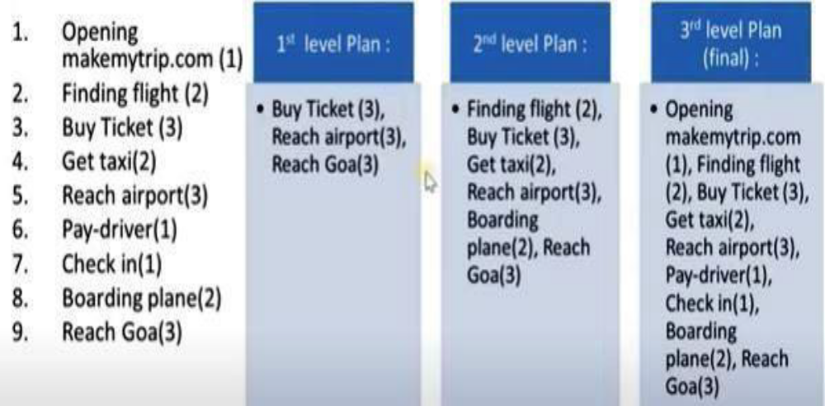
Planning for “Going to Goa this Cristmas”

Slide 32
Reactive Systems
Hierarchical planning and Non-linear planning systems are deliberative planning process, in which a plan for completing an entire task is constructed prior to action.
The idea of reactive systems is to avoid planning altogether, and instead use the observable situation as a clue to which one can simply react.
It chooses actions one at a time; it does not anticipate and select an entire action sequence before it does the first thing. Example: Thermostat
The job of the thermostat is to keep temperature constant inside a room. The real thermostat uses simple pair of situation-action rule.
If the temperature in the room is k degrees above the desired temperature, then turn the air condition on. If the temperature in the room is k degrees below the desired temperature, then turn the air condition off.
An intelligent system with limited resources must decide when to start thinking, when to stop thinking and when to act.
Some mechanisms for suspending plan execution is needed so that the system can turn its attention to high priority goals.
Finally some situations require immediate attention and rapid action.
For this reason, some deliberative planners compile out relative sub systems based on their problem solving experiences.

Slide 33
Advantages
Robustness — operate robustly in domains that are difficult to model completely and accurately Extremely responsive — attractive for real time tasks like driving and walking.
Triangle tables- Provides a way of recording the goals that each operator expected to satisfy as well as the goals that must be true for it to execute correctly.
Meta-planning- A technique for reasoning not just about the problem solved but also about the planning process itself.
Macro-operators-Allow a planner to build new operators that represent commonly used sequences of operators.
Case-based planning- Re-uses old plans to make new ones.

Slide 34
Understanding
To understand something is to transform it from one representation into another, where this second representation has been chosen to correspond to a set of available actions that could be performed and where the mapping has been designed so that for each event, an appropriate action will be performed.
There is very little absolute in the notion of understanding. If you say to an airline database system "I need to go to New Delhi as soon as possible," the system will have "understood" if it finds the first available plane to New Delhi.
If you say the same thing to your best friend, who knows that your family lives in New York, she will have "understood" if she realizes that there may be a problem in your family and you may need some emotional support.
As we talk about understanding. It is important to keep in mind that the success or failure of an "understanding" program can rarely be measured in an absolute sense but must instead be measured with respect to a particular task to be performed.
Computer understanding has so far been applied primarily to images, speech and typed languages. It is important to keep in mind that the success or failure of an “understanding” problem ca n rarely be measured in an absolute sense but must instead be measured with respect to a particular task to be performed.

Slide 35
Understanding is the process of mapping an input from its original form to a more useful one.
The simplest kind of mapping is “one-to-one”. In one-to-one mapping each different problems would lead to only one solution. But there are very few inputs which are one-to-one.
Other mappings are quite difficult to implement. Many-to-one mappings are frequent is that free variation is often allowed, either because of the physical limitations of that produces the inputs or because such variation simply makes the task of generating the inputs.
Many-to-one mapping require that the understanding system know about all the ways that a target representation can be expressed in the source language.
One-to-many mapping requires a great deal of domain knowledge in order to make the correct choice among the available target representation.
The mapping process is simplest if each component can be mapped without concern for the other components of the statement. If the number of interactions increases, then the complexity of the problem will increase.
In many understanding situations the input to which meaning should be assigned is not always the input that is presented to the under stander.

Slide 36
What Makes Understanding Hard?
There are some factors that contribute to the difficulty of an understanding problem.
If the target representation is very complex for which you cannot map from the original representation.
There are different types of mapping factors may arise like one-to-one, one-to-many and many-to-many.
Some noise or disturbing factors are also there.
The level of interaction of the source components may be complex one.
The problem solver might be unknown about some more complex problems.
The intermediary actions may also be unavailable.
Consider an example of an English sentence which is being used for communication with a keyword-based data retrieval system.
Suppose I want to know all about the temples in India.
So I would need to be translated into a representation such as the above sentence is a simple sentence for which the corresponding representation may be easy to implement.

Slide 37
Consider the following query.
“Ram told Sita he would not eat apple with her. He has to go to the office”.
This type of complex queries can be modeled with the conceptual dependency representation which is more complex than that of simple representation.
Constructing these queries is very difficult since more information to be extracted. Extracting more information will require some more knowledge.
Understanding as Constraint Satisfaction
There are two important steps in the use of constraints in problem solving:
Analyze the problem domain to determine the actual constraints.
Solve the problem by applying a constraint satisfaction algorithm.
Example: Waltz algorithm for labelling line drawings

